Slide 1


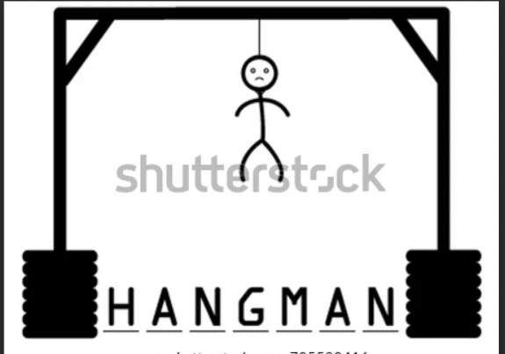
HAngman GAME BY C
By:VIRTI PRATIKKUMAR SHAH
DIV:6B
ROLL NO:273
Branch:CE

Slide 2
Introduction
Hangman is a simple word guessing game where
Host chooses a word to guess
Host set the number of word guesses
Player tries to guess the word by entering letters
If player has entered all right letters before a hanged man is displayed or in given number of guesses, then player has won the game
If player entered 10 wrong guesses before word is guessed, then player has lost the game

Slide 3
Strategy
Most of the words has one or more vowels so try to guess a vowel(A,E,I,O,U)
Strategically pick your first vowels based on word length
A is the most common vowel
E is most common in 6 to 12 words
I is most common in 13 & longer letter words
O is most common in short & long length words than in mid length words
U is always the least common

Slide 4
Language & Libraries Uses
C language used
stdio.h
conio.h
string.h
stdlib.h

Slide 5
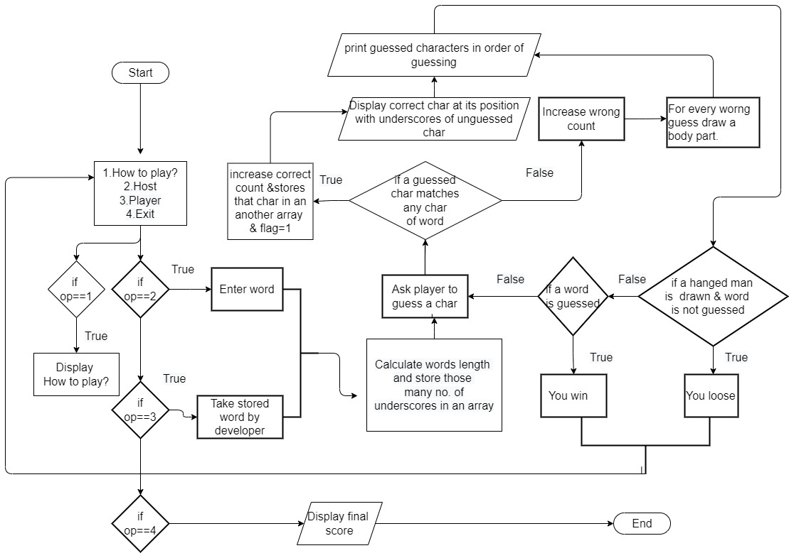
Flowchart

Slide 6
Thank you

